Slide 1
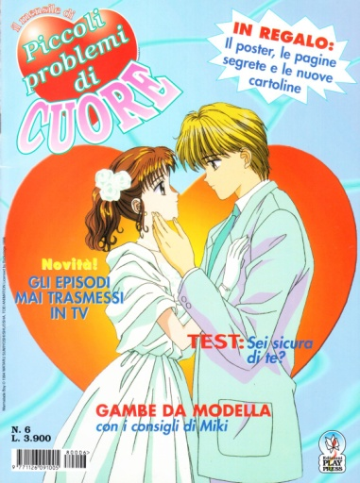
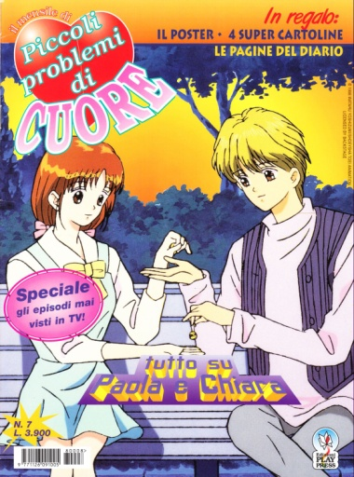
Marmalade boy – Rivista “Play Press”
1
2
3
4
5
6
7
8

